Slide 1
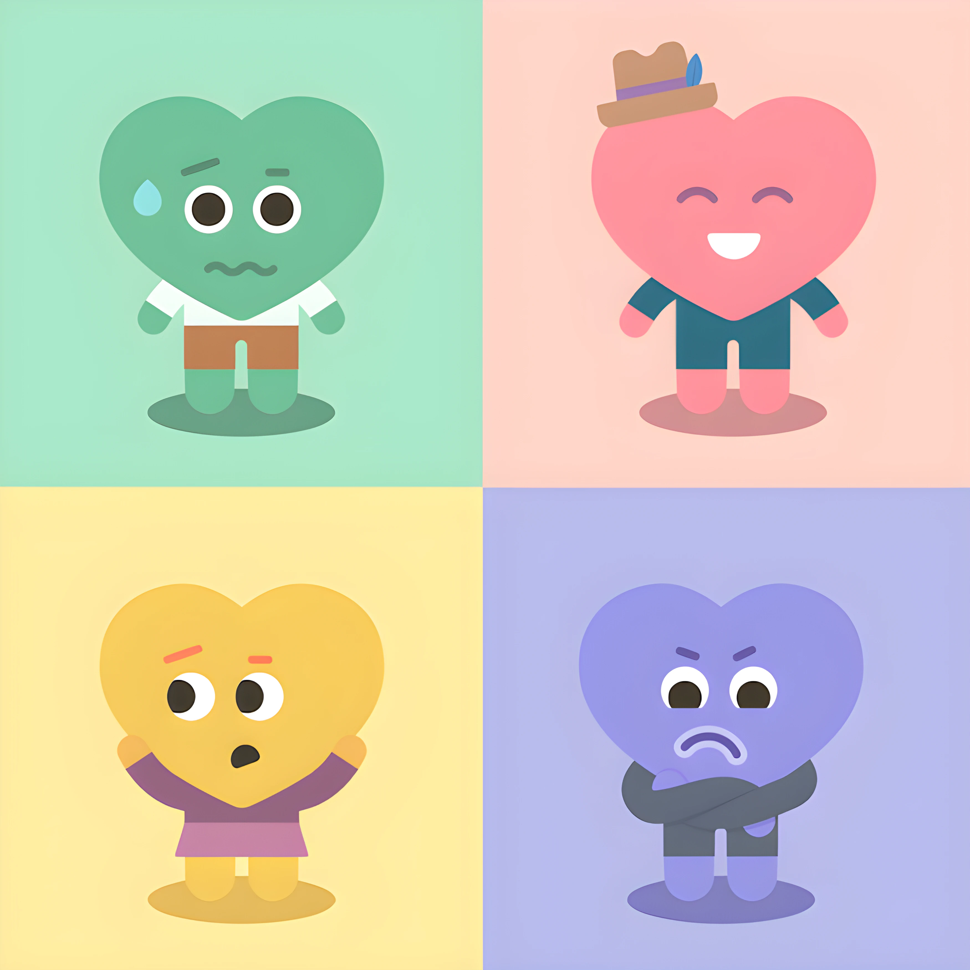
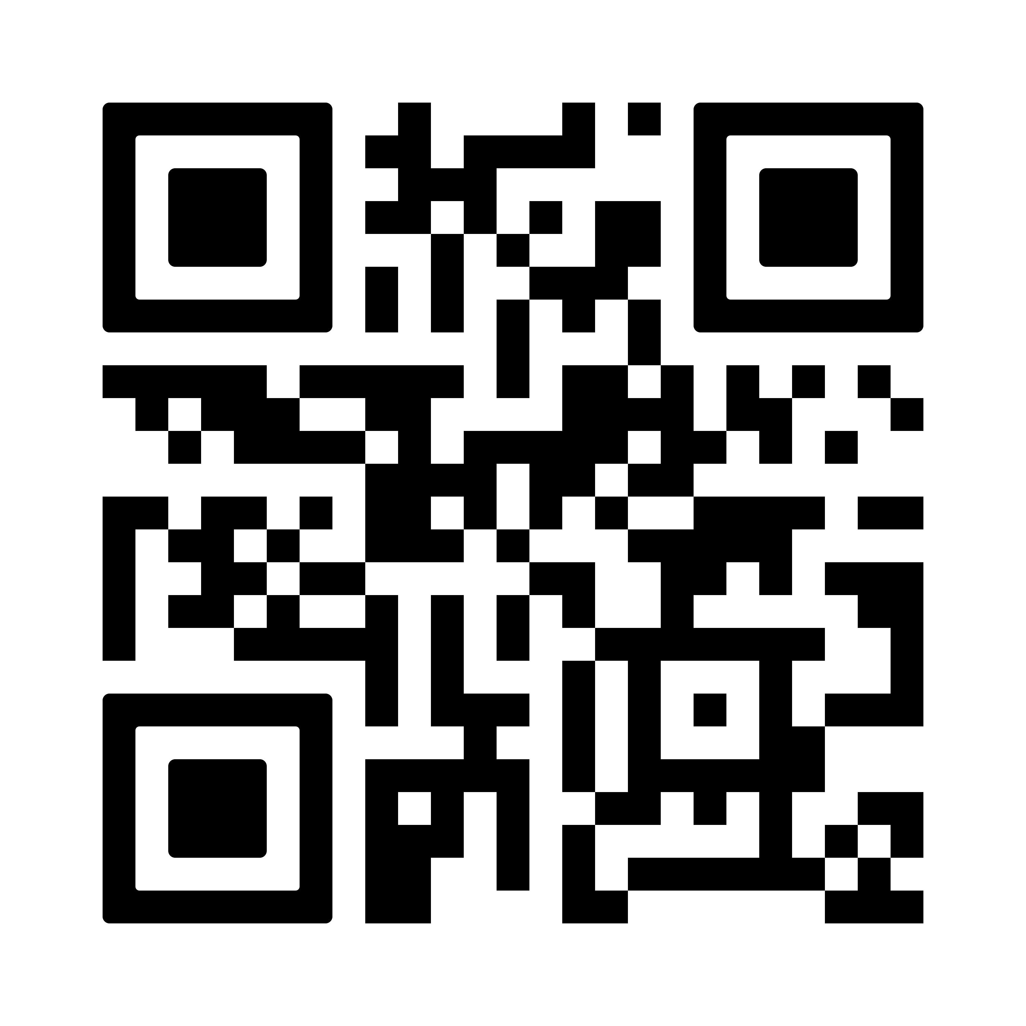
Impact of Childhood Trauma On Adult Attachment Style
Luella Rubin-Wylie & Desiree Crevecoeur-MacPhail
Crean College of Health and Behavioral Sciences
Chapman University
Background
Hypotheses
Results
The attachment theory proposed by John Bowlby states that attachment styles are developed in the early years of an individual's life. An individual may develop an insecure attachment style if their physical needs are not met, if they are not given affection, if they are physically hurt, or if they experienced or were exposed to violence (Bowlby, 1982; Karakus, 2012).
Hazan and Shaver examined the theory and looked at adult attachment, which places adults into three categories: secure, anxious, and avoidant (Toof et al., 2020; Sable, 2007).
Various traumatic experiences during childhood, such as abuse/neglect, death/separation of a parent, or witnessing domestic violence, may lead individuals to develop insecure attachment styles in their future romantic relationships and can negatively affect a child’s functioning in their adult lives in relationships with their families, friends, and romantic partners. (Erozkan, 2016).
Previous studies have found that children who have been physically abused are more likely to have higher rates of anxious or avoidant attachment styles and lower rates of secure attachment compared to non-abused children (Unger & De Luca, 2014)
In addition to earlier life experiences, the history and characteristics of romantic partners can also influence a person's relationship experience, and those who once had secure attachments may develop insecure attachments if they experience a period of interpersonal conflict (Riggs et al., 2011; Davilla, 2017).
Insecure attachments can result in various relationship issues, such as dissatisfaction and instances of intimate partner violence. Those who reported avoidant attachment styles also showed increased childhood trauma experiences and dating violence victimization compared to other attachment styles (Stover et al., 2018)
Childhood abuse, in addition to insecure attachment styles, can cause relationship dissatisfaction. One study found a statistically significant relationship between CSA and relationship dissatisfaction (Baker et al., 2022).
Individuals with an avoidance attachment style have been found to have lower emotional competencies, which also causes lower relationship satisfaction (Monaco et al., 2022).
Repeated trauma experienced during childhood can lead adults to develop insecure attachment styles in their future romantic relationships.
Trauma experienced in later adolescents can cause individuals who have secure attachments with their parents to develop insecure attachment styles with their romantic partners.
Individuals with insecure attachment styles are more likely to experience intimate partner violence in their romantic relationships than those with secure attachment styles.
Childhood trauma has a negative impact on romantic relationship satisfaction.
Hypothesis 1
ACE and ECR (anxious)- r=.15, p=.195
ACE and ECR (avoidant)- r=.1, p=.400
Hypothesis 2
Age of trauma and ECR (anxious): r=.2, p=.174
Age of trauma and ECR (avoidant ): r=.1, p=.449
Hypothesis 3
ABI and ECR (anxious)- r=.24, p=.031
ABI and ECR (anxious)- r=.16, p=.17
Hypothesis 4
ACE and RAS: r=-.1, p=.333
a
Discussion
Summary of Results:
No significant correlation was found for H1,H2 and H4
A positive significant correlation was found for ABI and anxious attachment for H3
Limitations
Small sample size
One measure asked students to self-report attachment style with parents
The ECR-Q only measured avoidant and anxious attachment and did not measure disorganized attachment
Future Research
Future research could examine the gender differences in attachment styles among those who experience childhood trauma.
Implications
Implications of this study could offer therapists insights into the correlation between childhood trauma and attachment style in adulthood.
Understanding the devastating effects of childhood trauma on attachment style in adult romantic relationships, therapists can develop more effective strategies to work with patients through their childhood trauma and possibly alleviate the development of insecure attachments within adult romantic relationships.
b
Methods
Anxious
Secure
References
Students from Chapman University and California State University, Dominguez Hills, completed an online survey.
They answered four online questionnaires:
The Adverse Childhood Experiences Questionnaire
The Experiences in Close Relationships Questionnaire
The Abuse Behavior Inventory
The Relationship Assessment Scale
Participants took the survey on their own time in a location of their choosing.
Acknowledgments- A big thank you to Dr. Desiree Crevecoeur- MacPhail for her guidance, contributions, and help during this research process.
Disorganized
Avoidant

