Slide 1
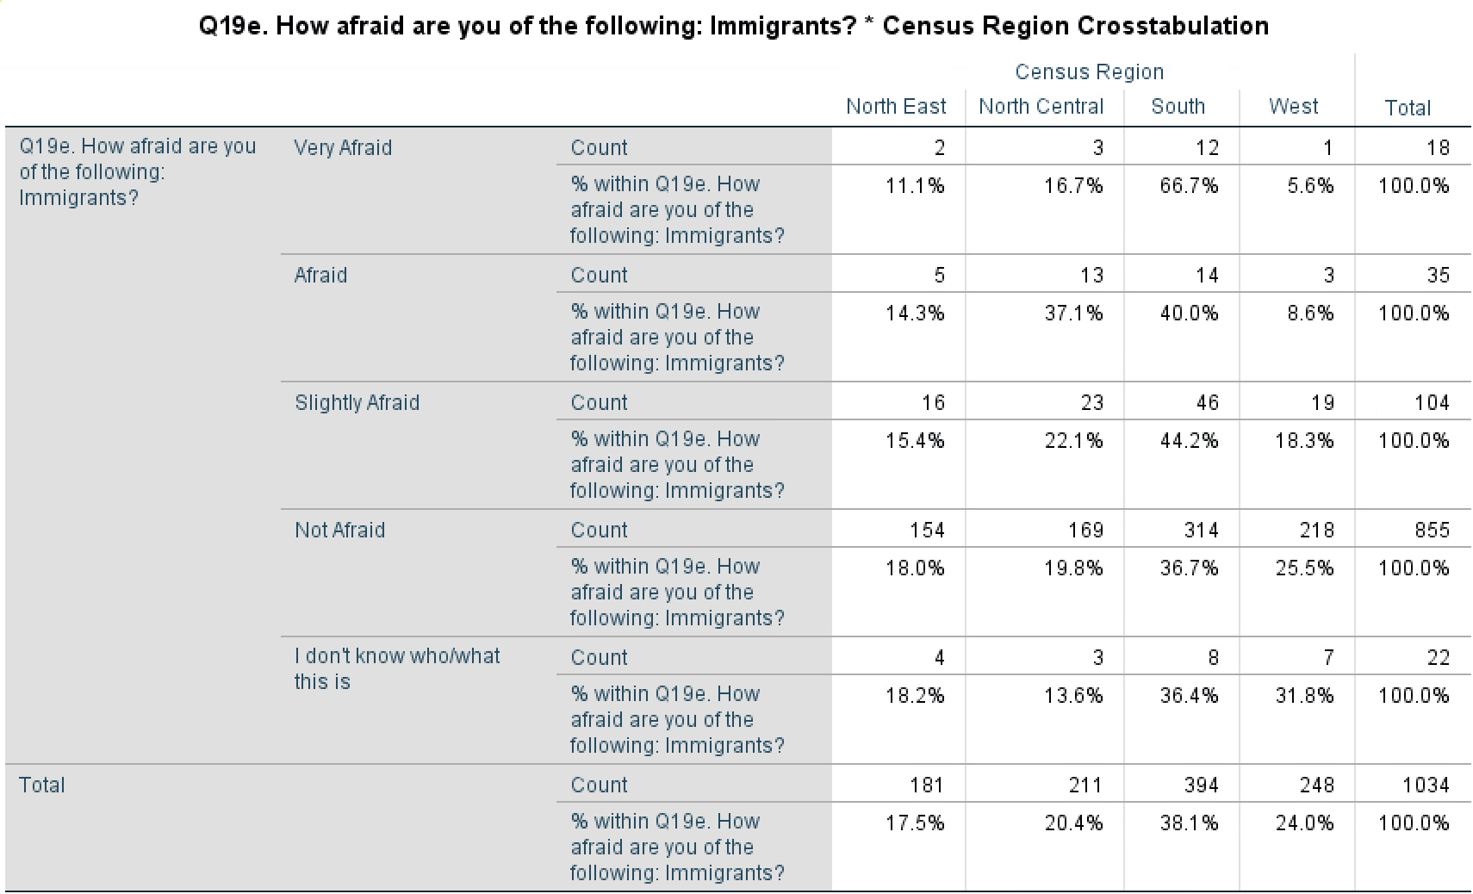
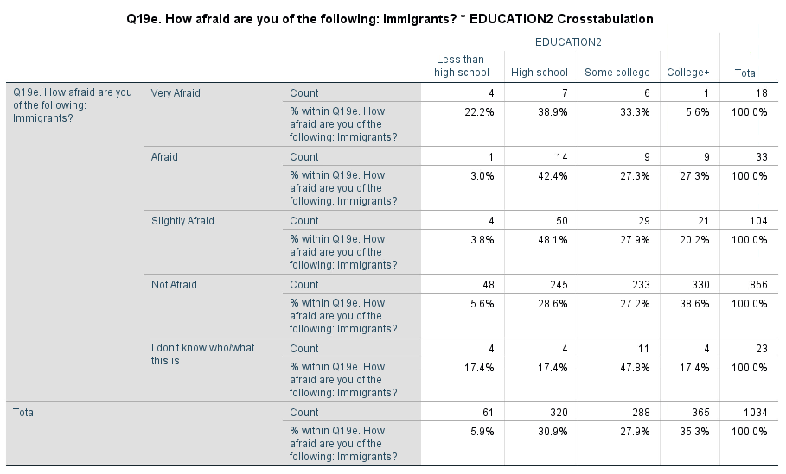
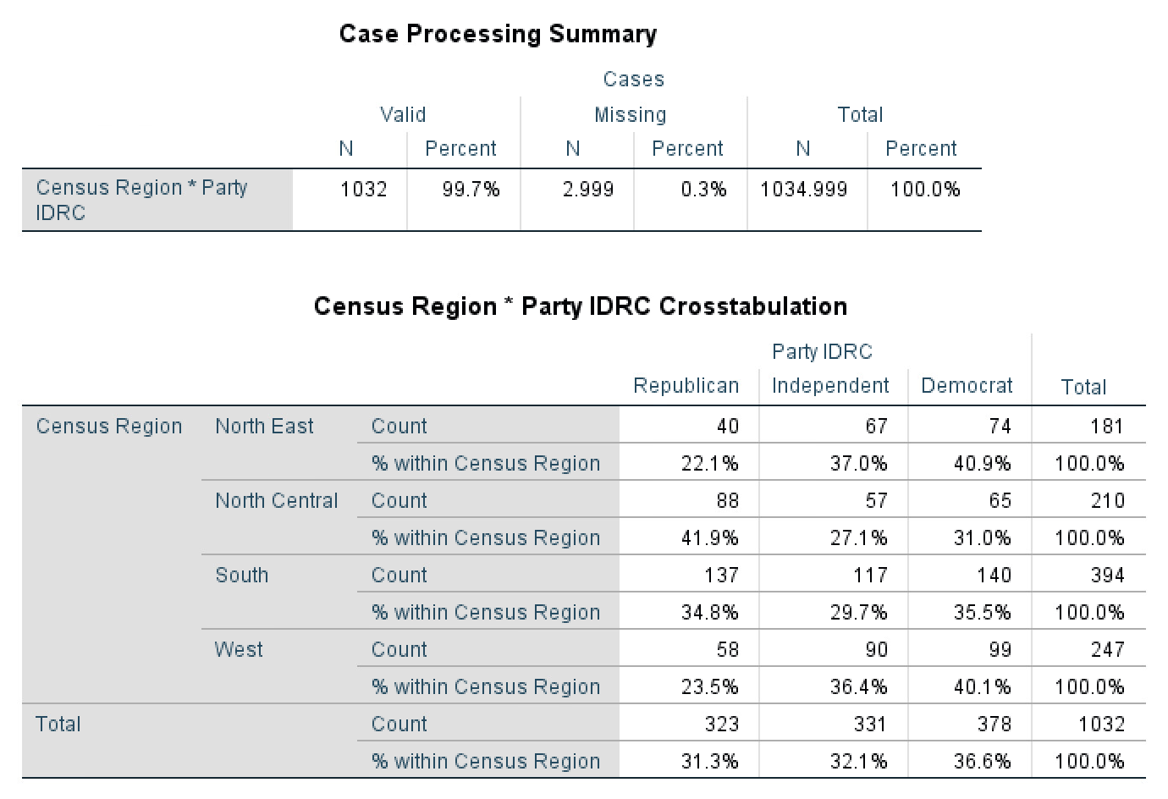
MEDIA FRAMES AND THEIR IMPACT ON SUPPORT FOR IMMIGRANTS AND IMMIGRANT POLICIES
Lisbeth Rosales
Department of Political Science, Chapman University; Orange, California
Introduction to Research
The way immigrants are portrayed in the media differs depending on the political leanings of the media publishing or broadcasting reports.
Most left leaning media portray immigrants as people who should be helped and are seeking refuge from the instability in their home countries, whereas the right leaning media portrays immigrants as having committed a crime by crossing the border and in a negative light.
An effective use of either frame can shape American public opinion and the support they place behind such policies.
Hypotheses:
H1: Those who live in the South are more likely to fear immigrants than those who don’t.
H2: Those living in the South are more Republican, on average than those living in other regions.
H3: The higher the level of education, the less likely to fear immigrants..
Findings
H 1: Living in the South & fear of immigrants
My first hypothesis is confirmed as those that said they are very afraid of immigrants showed 66.7% of the respondents were from the South. This is a significant percentage difference when compared to the other regions.
H 2: Living in the South and party identification
My second hypothesis, that those who live in the South tend to be more conservative was not confirmed. Only 34.8% identified as Republican which does not show a significant percentage difference across parties. The North Central respondents had a larger ratio of Republican identifiers at 41.9% as well.
H 3: Level of education & fear of immigrants
My third hypothesis that higher education levels would lead to less fear of immigrants was proven correct. The cross-tabulation shows that only 5.6% of those that said they were very afraid of immigrants had a college degree or higher education. Versus, 38.6% of those who said they weren't afraid had a college degree or higher. In addition, amongst those that said they were very afraid of immigrants, 61% of the respondents had their highest level of education as high school or less.
Data
H 1: Living in the South & fear of immigrants
H 3: Level of education & fear of immigrants
Lit Review
Research demonstrates that equivalency frames do not matter for public opinion but when focusing on the immigration history of one’s family they found that support for legalization is lower for the first and second generation immigrants.
The use of the term “illegal” has a significant impact on first and second generation immigrants which makes them oppose policies regarding immigrants but they tend to support it when “un-athorized” or “undocumented” terms are used. Overall, issue frames matter more regarding policy issues while equivalency frames do not.
Research also shows that both location and political ideology played a role in framing arguments for and against immigrants, with national newspapers framing their arguments as threats and more in support for the bill.
Overall, this finding implies that other areas, even those not close to the border perceive immigration as a threat. The threats that were used by conservative newspapers to frame support for the bill were more likely to activate fear within the public.
Episodic frames are very harmful to immigrants as they can portray them as deviants and as threats due to the lack of discussions of societal factors. These episodic frames also focused on stories of violence involving immigrants, arrests, imprisonment, and smuggling cases (Berggreen 2009).
Being portrayed in a negative manner causes immigrants to not feel safe, to feel as outsiders and it can lead to a divided community.
Conclusions
My two confirmed hypotheses were the higher the education the less likely to fear immigrants and that those from the South will be more afraid of immigrants. These are both important findings as level of education helps reduce a fear of immigrants and can be used in the future to help reduce fear of immigrants and create a sense of understanding.
My other finding is especially significant as those who live in the South displayed a higher fear of immigrants, this shows a relationship with the sources used as most border crossings occur along the southern states.
The hypothesis that was not confirmed was party identification and fear of immigrants and while this is surprising, I expect to do more research in the future to find out what factors affected this. A possible reason could be more people from northern states moving to the south and disrupting the perceived party identification of these states.
H 2: Living in the South and party identification
References
Berggreen, S.-L. C., Crapanzano, T. R., & Eastman, C. L. S. (2008). Framing the Voiceless: News Conventions and the Undocumented Children in the United States. Asia Pacific Media Educator, 19, 127–141.
Fryberg, S. A., Stephens, N. M., Covarrubias, R., Markus, H. R., Carter, E. D., Laiduc, G. A., & Salido, A. J. (2012). How the Media Frames the Immigration Debate: The Critical Role of Location and Politics. Analyses of Social Issues and Public Policy, 12(1), 96. https://doi-org.libproxy.chapman.edu/10.1111/j.1530-2415.2011.01259.x
Merolla, J. L. . aut. (2013). “Illegal,” “undocumented,” or “unauthorized” equivalency frames, issues frames, and public opinion on immigration Jennifer Merolla, S. Karthick Ramakrishnan, and Chris Haynes.
*Significant at <.05
R square for the model is .332

